Slide 1









SPLITTER
An Expense Management System
Made by- Ankur Pandey
Harshita Mahajan
Sairaj Rajput
Sapna Rani

Slide 2

ABOUT OUR
PROJECT
The Expense Management System is a web application built with Angular that helps users manage shared expenses within groups.
Helps users manage shared expenses within groups.

Slide 3
ARCHITECTURE OVERVIEW
The app is structured in a feature-first style with clear separation of concerns:
Auth → JWT-based authentication, middleware for protecting routes.
Backend → server.js with Express API, authMiddleware.js for security and serverData.json for mock persistence.
Group → Create groups and list all groups the user is part of.
Expense → Add expenses within groups, calculate balances (owed/owes).
Core → HTTP interceptor for exception handling, guards for authentication.
Shared → Common Angular components, services, and utilities reused across modules.
Build/Deploy → Production build artifacts inside dist/expense-tracking-project.
PWA → Configured with ngsw-config.json for service worker support.
Routing: Routes cover authentication, group listing, and expense logging. Guards ensure authentication before accessying feature modules. Backend middleware enforces token-based security on API endpoints.

Slide 4
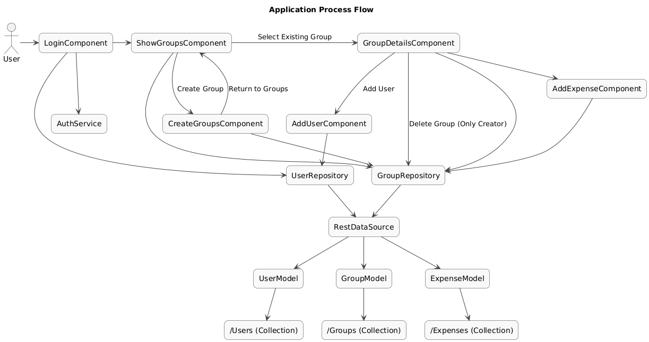
FLOWCHART

Slide 5
FLOWCHART
USER LOGIN
ADMIN LOGIN

Slide 6
FLOWCHART
CREATE GROUP
ADD USER
ADD EXPENSE

Slide 7
THANK
YOU

